Slide 1
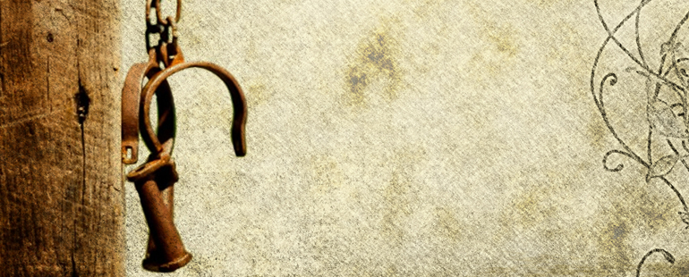
For Love’s Sake
Philemon 1:1-22
Pastor Rod Lago

Slide 2
Historical background of the book
The Letter to Philemon was written by Paul to Philemon who lived in Colosse. A city of Phrygia in Asia Minor (modern day Turkey)
This was a private letter to Philemon, a fellow worker and convert of Paul, in regards to his slave, Onesimus. Philemon, along with his wife Apphia and son Archippus, would lead of group of Christian converts at their home in the Gentile city of Colosse.
The beautiful and intimate letter to Philemon is one of the four captivity letters, the others being Ephesians, Colossians and Philippians, that Paul wrote during his first captivity in Rome, which most believe was written around A.D. 63 or early A.D. 64.

Slide 3
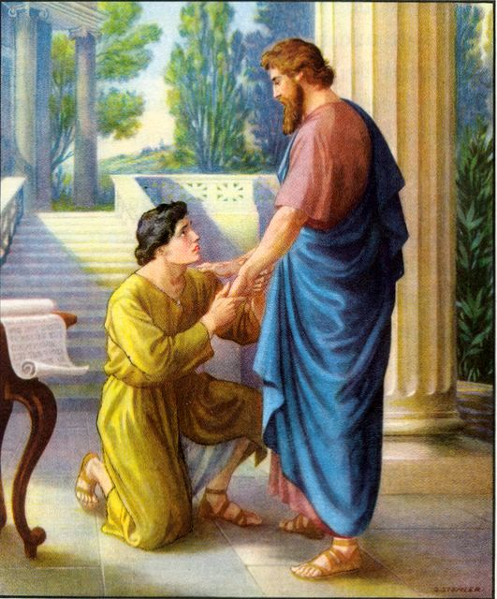
Life of Philemon :
Philemon is described by Paul as a faithful worker for Jesus Christ.
Philemon was a man of love and faith.
Who was an inspiring and devoted leader and a great encourager in the church of Colosse.
He was a man who’s home was open to the saints for the worship of the Lord.

Slide 4
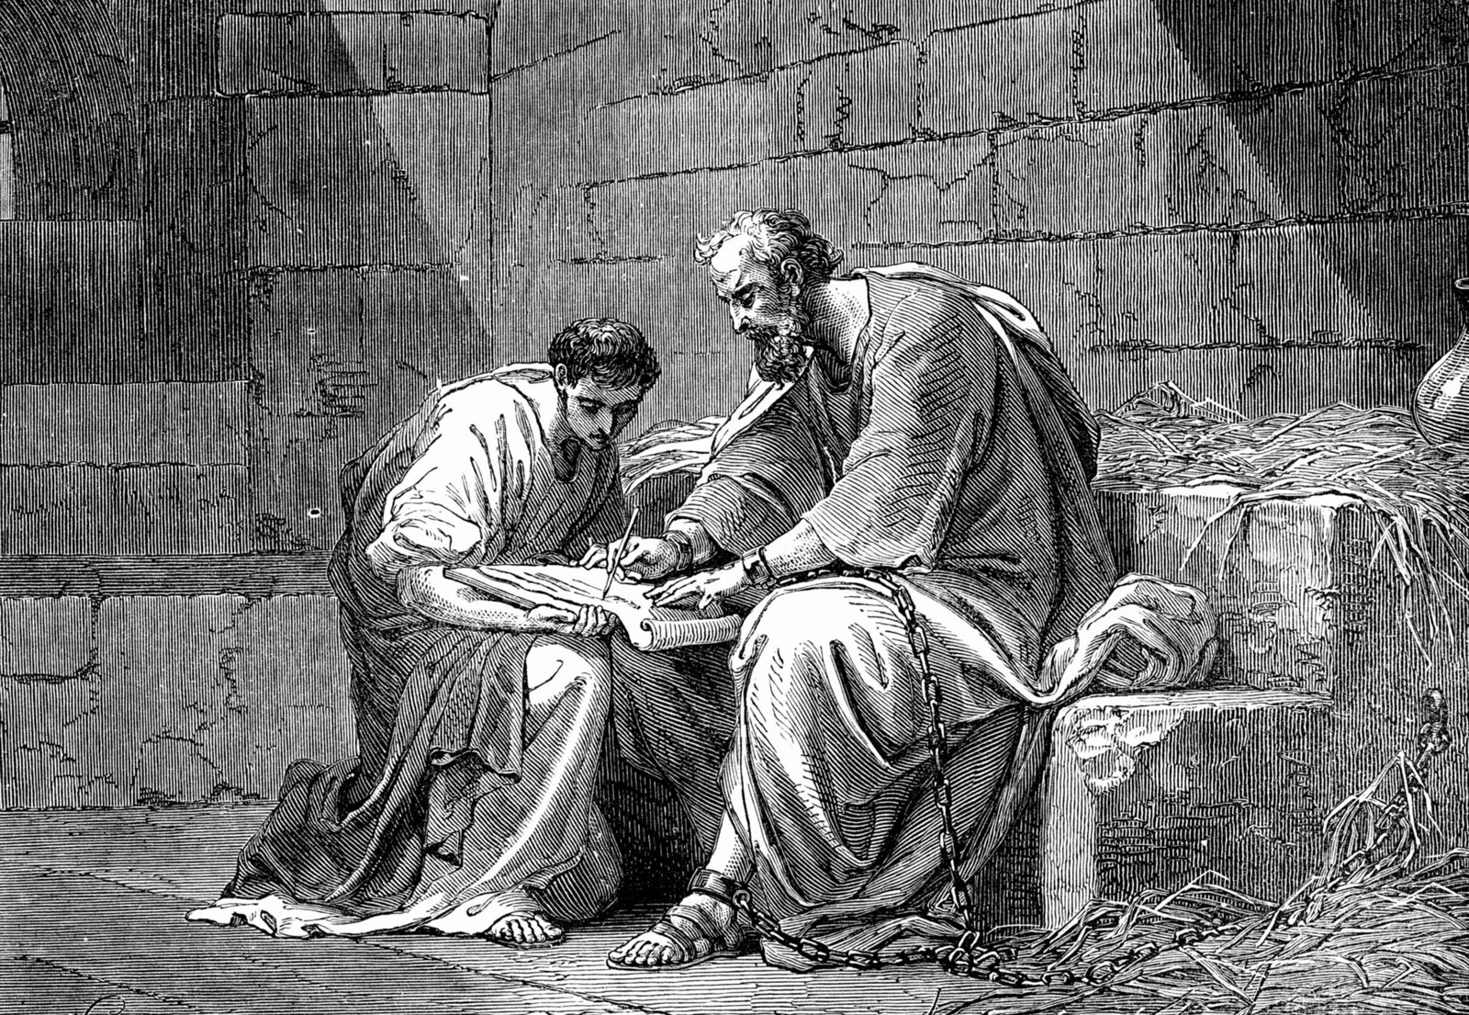
Life of Onesimus:
Onesimus on the other hand was the slave of Philemon.
Who decided to leave his master while taking something of great value from him.
Onesimus eventually ends up in Rome where he meets Paul who’s in jail and through the word of God from Paul, Onesimus becomes a believer and follower of Christ.

Slide 5
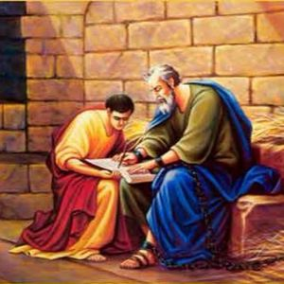
Onesimus stays with Paul until his conversion was proven sincere and truthful.
Confident in Onesimus conversion, Apostle Paul writes to Philemon.
Apostle Paul calls upon Philemon to accept Onesimus freely “for love’s sake.”
Because Apostle Paul believed that in everything we do “LOVE” must be the basis of all.

Slide 6
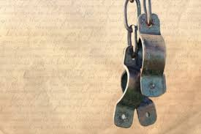
Three things that we can learn in the book of Philemon.
Love and Forgiveness
Doctrine of Imputation (Credit from one account to another)
The Power of Helplessness

Slide 7

I. LOVE and FORGIVENESS. v.8-9
We, as Christians must extend ourselves to other people with love, and that which flows out of love-forgiveness!

Slide 8

Ephesians 4:29-32
Do not let any unwholesome talk come out of your mouths, but only what is helpful for building others up according to their needs, that it may benefit those who listen. And do not grieve the Holy Spirit of God, with whom you were sealed for the day of redemption. Get rid of all bitterness, rage and anger, brawling and slander, along with every form of malice. Be kind and compassionate to one another, forgiving each other, just as in Christ God forgave you.

Slide 9

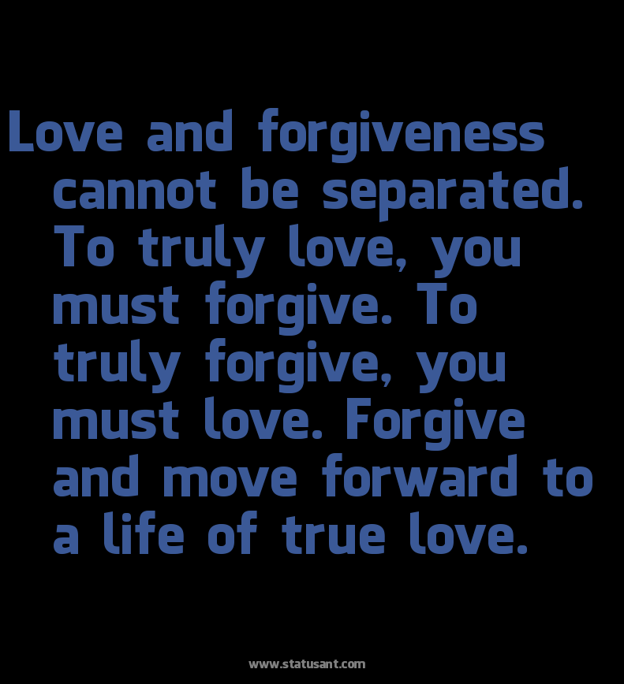
John 13:34-35 tells us,
A new command I give you: Love one another. As I have loved you, so you must love one another. By this all men will know that you are my disciples, if you love one another.

Slide 10
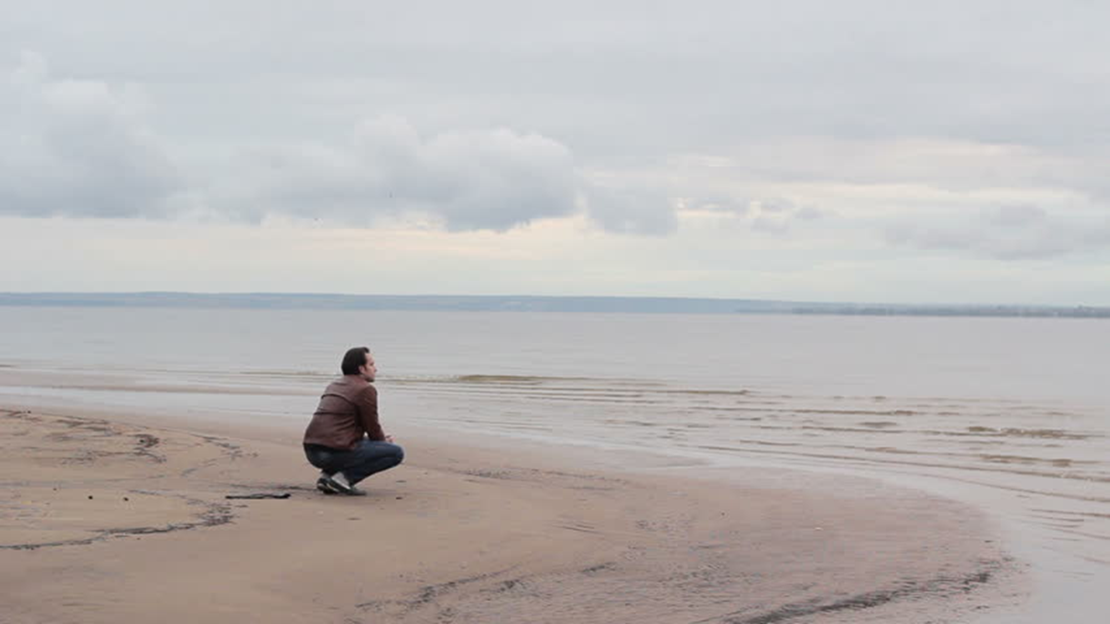
3 Truths about FORGIVENESS.

Slide 11
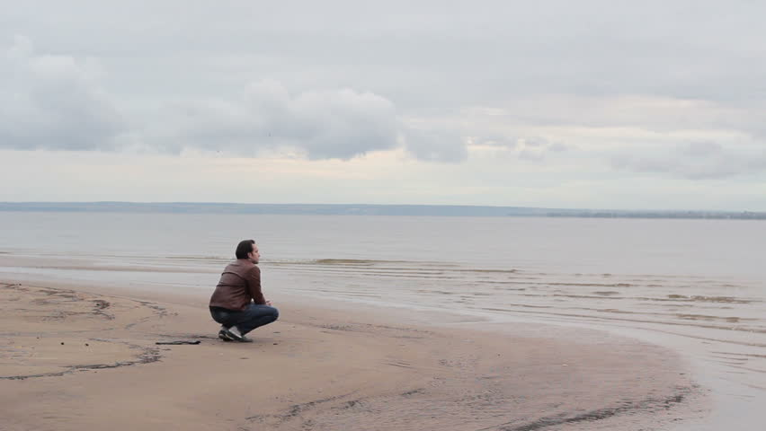
First: Forgiveness is Hard.
True forgiveness is one of the hardest things to accomplish in the human experience, even for the mature Christian. Yet, this is our mandate, and call.

Slide 12
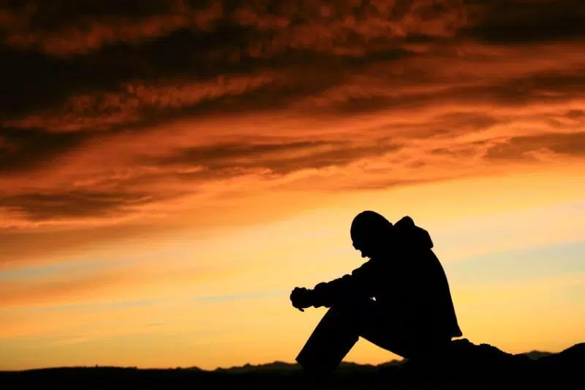
Second: Forgiveness is Complete.
Therefore, as God's chosen people, holy and dearly loved, clothe yourselves with compassion, kindness, humility, gentleness and patience. Bear with each other and forgive whatever grievances you may have against one another. Forgive as the Lord forgave you. And over all these virtues put on love, which binds them all together in perfect unity. (Colossians 3:12-14, NIV)

Slide 13
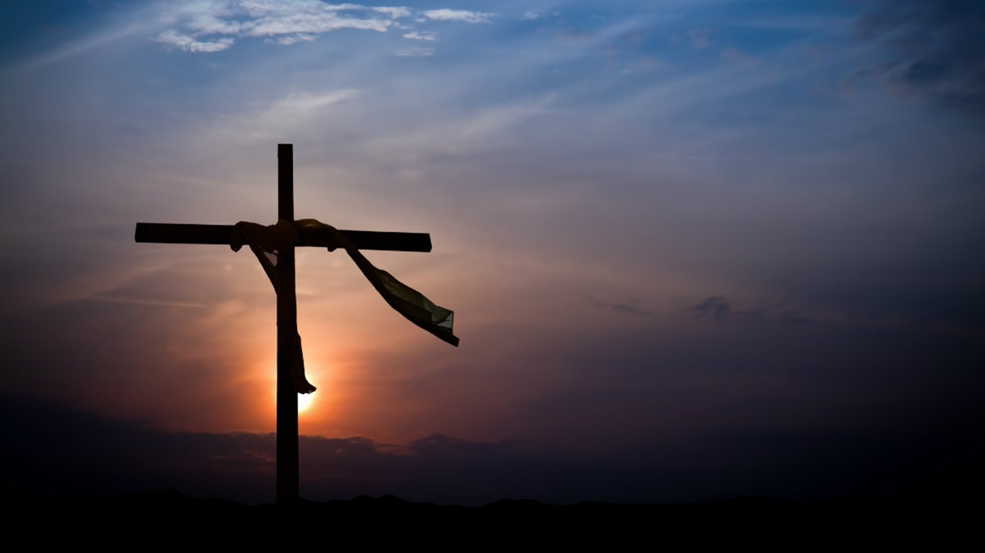
Third: Forgiveness is Costly.
But I tell you who hear me: Love your enemies, do good to those who hate you, bless those who curse you, pray for those who mistreat you. If someone strikes you on one cheek, turn to him the other also. If someone takes your cloak, do not stop him from taking your tunic. Give to everyone who asks you, and if anyone takes what belongs to you, do not demand it back. Do to others as you would have them do to you. (Luke 6:27-31, NIV)

Slide 14

Forgiveness is for our own growth and happiness. When we hold on to hurt, pain, resentment, and anger it harms us far more than it harms the offender.
When the pain of holding on to the wrongdoing in the past continues to follow you into the future, you have a choice. Be bitter or Be better.

Slide 15
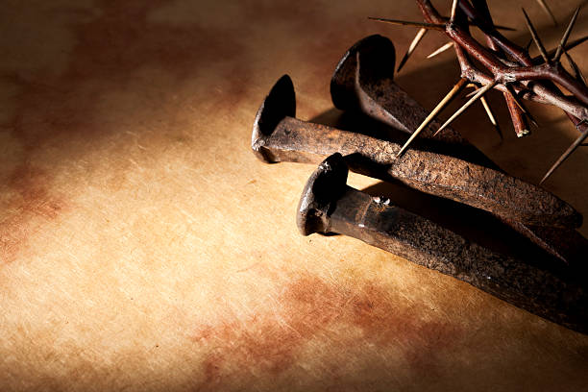
II. The Doctrine of
Imputation
Philemon 1:17-18
17 If then you count me as a partner, receive him as you would me. 18 But if he has wronged you or owes anything, put that on my account.
19 I, Paul, am writing with my own hand. I will repay—not to mention to you that you owe me even your own self besides.

Slide 16
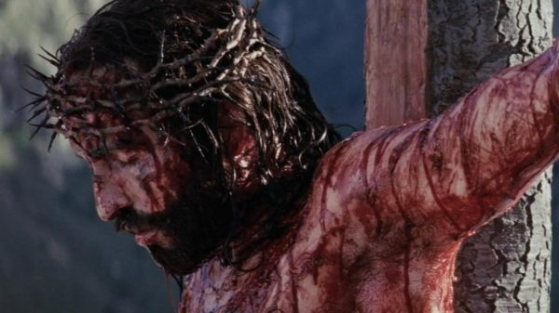
Jesus Christ died on the Cross. He took our sin and paid our debt by His own blood.

Slide 17
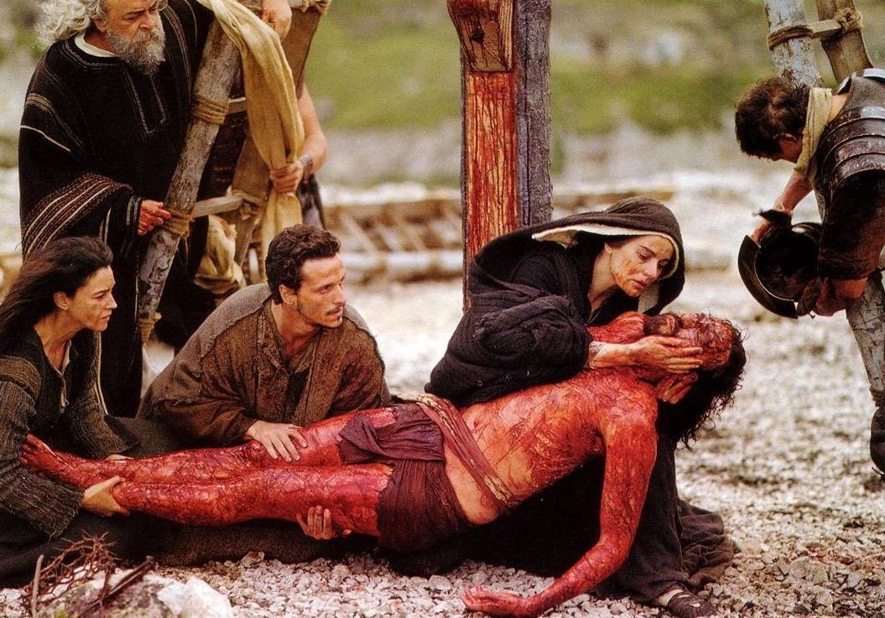
2 Corinthians 5:21 New King James Version
21 For He made Him who knew
no sin to be sin for us, that we might become the righteousness of God in Him.

Slide 18
1 Peter 2:24 New King James Version (NKJV)
24 who Himself bore our sins in His own body on the tree, that we, having died to sins, might live for righteousness—by whose stripes you were healed.
1 John 2:2 New King James Version (NKJV)
2 And He Himself is the propitiation for our sins, and not for ours only but also for the whole world.

Slide 19

III. Realize your Helplessness.
A. first, that we need a Savior. That we couldn’t save ourselves. ONLY BY HIS GRACE!
B. second, is our good works is a filthy rugs in the eyes of God.
C. third, Apart from Him, we cannot do anything. (Life is meaningless)

Slide 20
CONCLUSION:
Love and Forgive one another.
A. Let go and Let GOD. If you don’t it will destroy you, the worst it will kill you.
B. If we do not forgive there will be division, hurt, grudges and bitterness.
The Doctrine of Imputation.
A. Remember what God did for us in Christ.
B. Remember that Jesus Christ has paid our debt. He is the only way to
God.

Slide 21
3. Realize your HELPLESSNESS.
GOD without man is GOD, but man without GOD is nothing.
We need GOD every moment of our lives.

